Slide 1
AutoML based Augmentation to improve Synthetic Data
Project Group 3
Dheeraj Panneer Selvam
Majd Al Aawar
Dhruv Mehra

Slide 2
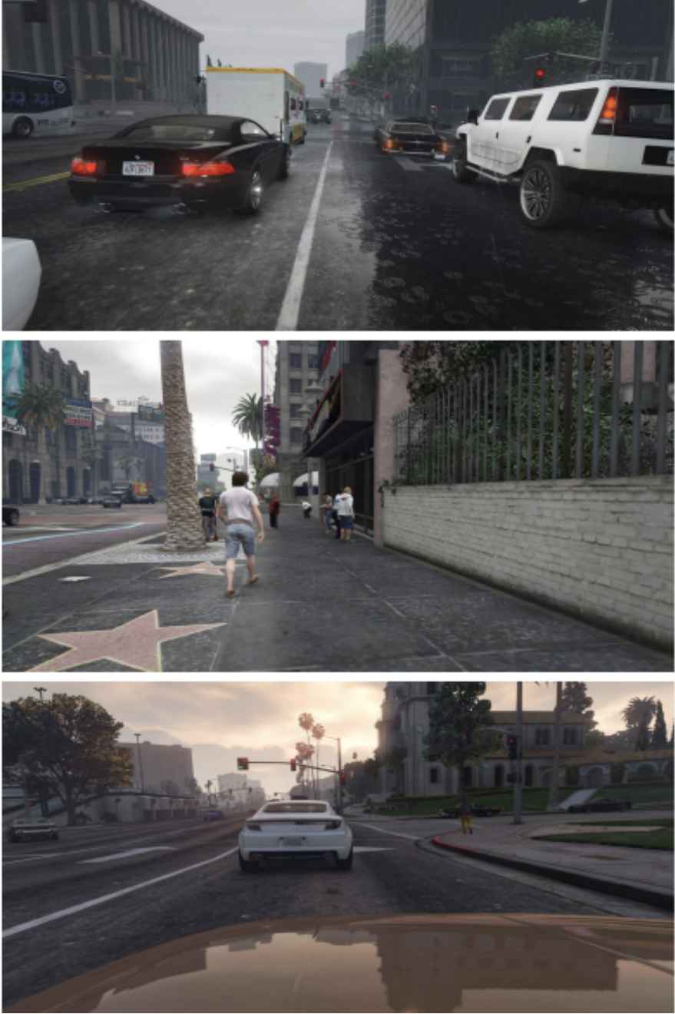
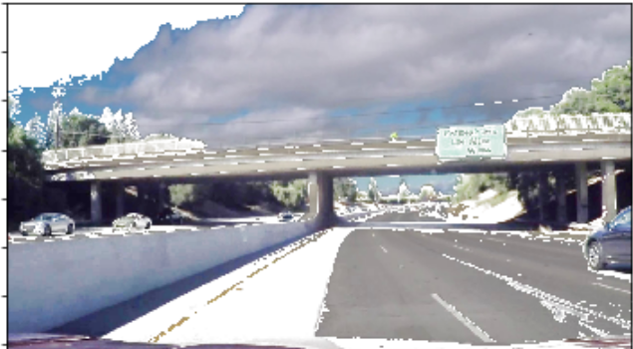
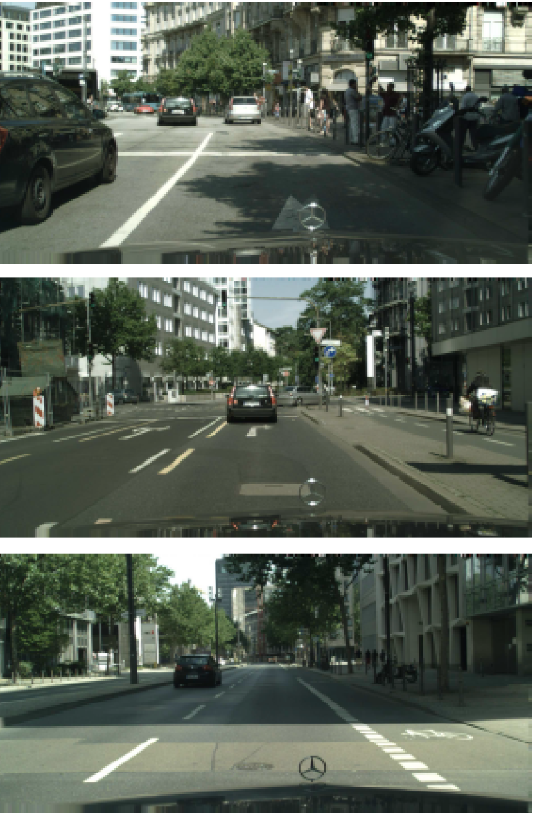
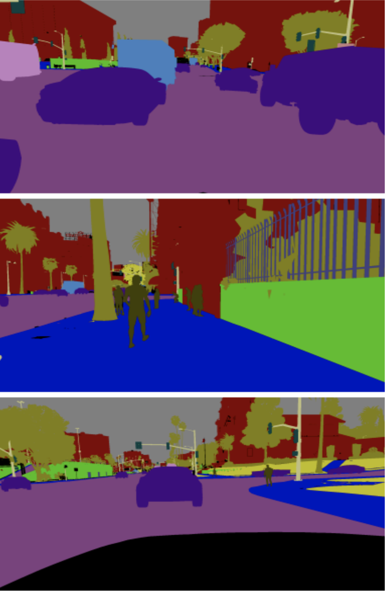
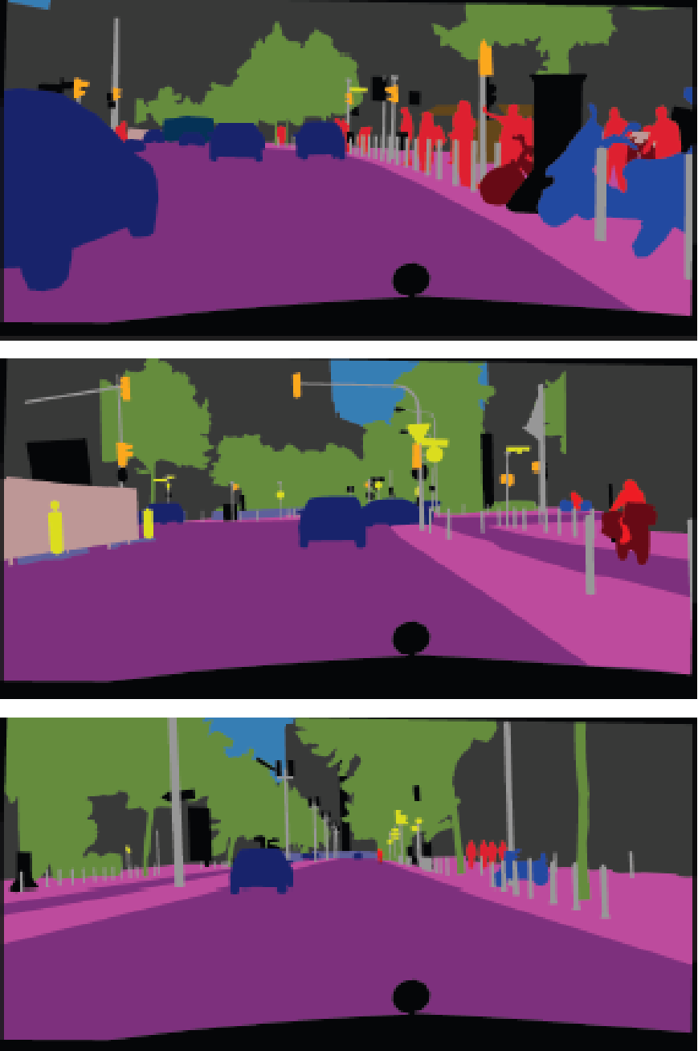
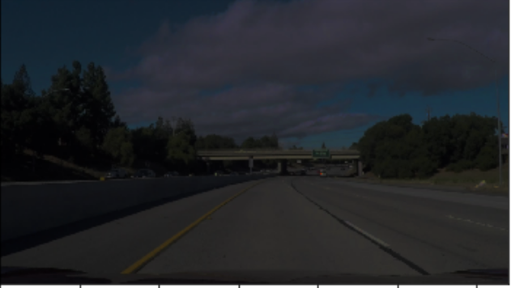
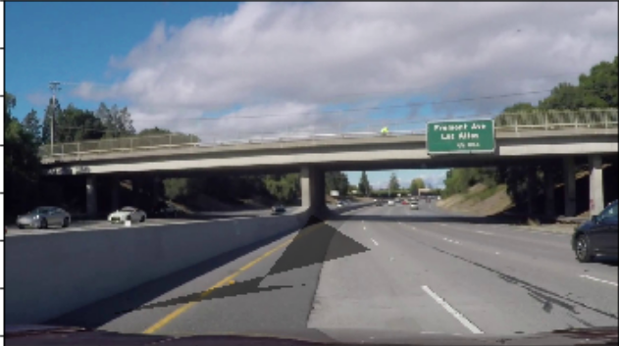
Introduction
Use of photo-realistic synthetic data to train real-world segmentation algorithm for self driving cars using a Bayesian hyperparameter optimization feedback data augmentation block
Synthetic Data
Feedback
Augmentation:
Fog
Rain
Brighten
Snow
.
.
.
Darken
Shadow
Real-World Data
Model Training:
Minimize training loss
Model Evaluation

Slide 3
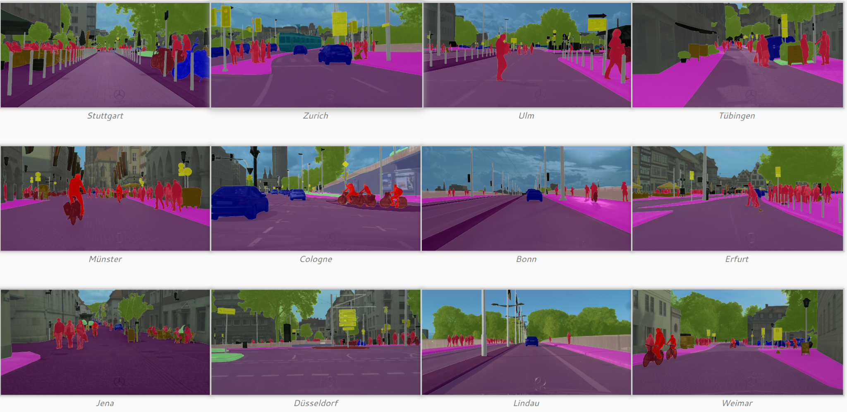
CityScapes
Large-scale database of stereo video sequences recorded from the streets of 50 different cities
Video sequences collected from in front of a car focusing on semantic understanding of urban street scenes
5000 annotated images with fine annotations
Group | Classes
flat | road · sidewalk · parking · rail track
human | person · rider
vehicle | car* · truck* · bus · on rails · motorcycle · bicycle · caravan · trailer
construction | building · wall · fence · guard rail · bridge · tunnel
object | pole · pole group · traffic sign · traffic light
nature | vegetation · terrain
sky | sky
void | ground · dynamic · static

Slide 4
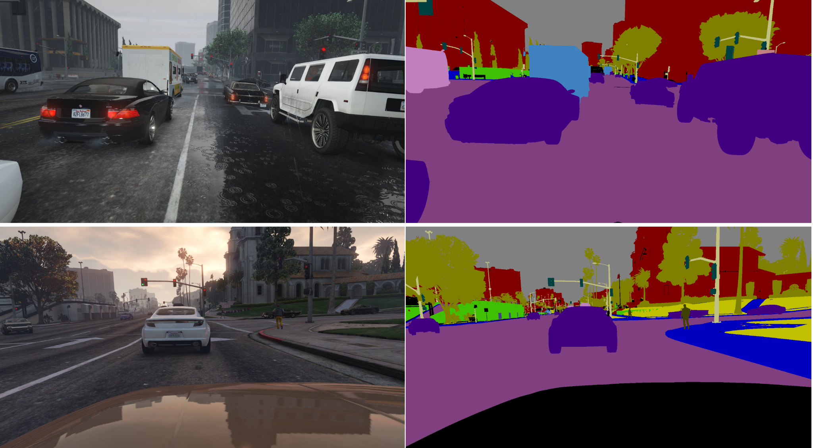
GTA5 - Synthetic dataset
GTA5: Photorealistic open-world computer game emulating American-style cities
Dataset collected from in-game emulated environments
Labels generated by deconstructing game and hardware communications
24966 annotated images with fine annotations
Labels compatible with CitySpaces and CamVid dataset

Slide 5
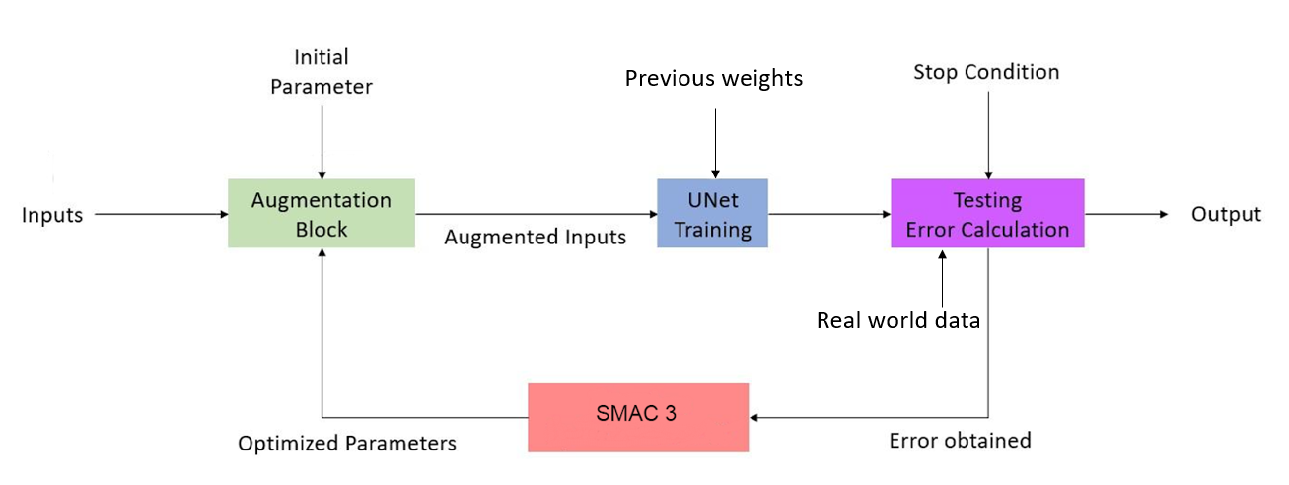
Overview of pipeline

Slide 6
Overview of pipeline

Slide 7
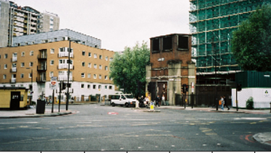
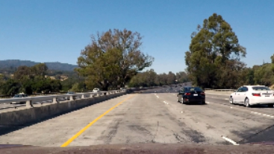
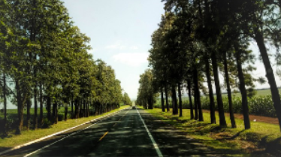
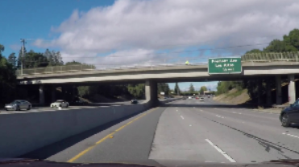
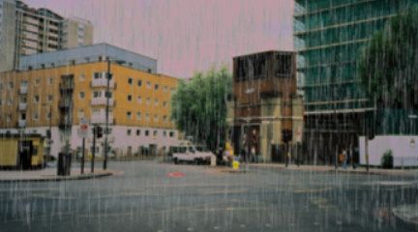
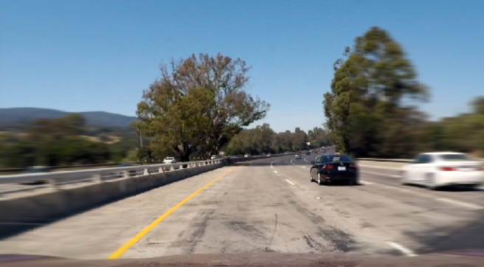
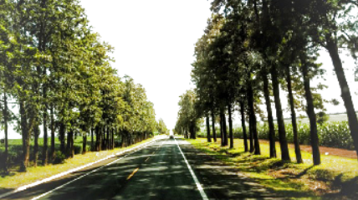
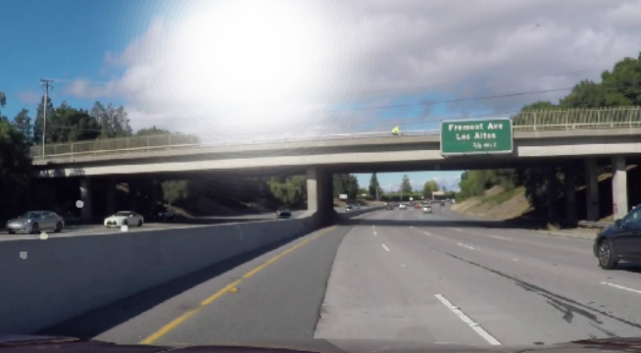
Automold:Road-Augmentation-Library
Original
Augmented
Augment | rain | fog | gravel | snow | flip | shadow | autumn | manhole | brightness | speed | Sun flare
Time (s) | 0.02 | 0.37 | 0.04 | 0.06 | 0.0 | 0.01 | 0.31 | 0.01 | 0.05 | 0.2 | 0.09
Inference on a single 1280x720 image

Slide 8
Augmentation Block
Requires 4 inputs:
Augmentation Distributions
Augmentation parameters
Images
Augmentation Block
Augmented
Output
Labels

Slide 9
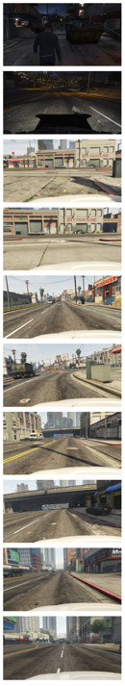
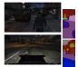
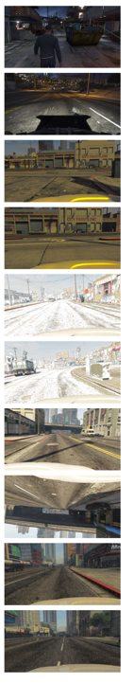
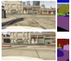
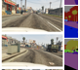
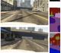

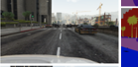
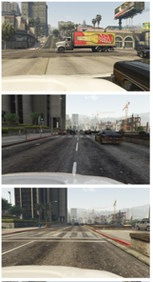
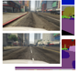
Augmentation Block - Anatomy
20 images, labels
Parameter 1
Brightness
[0.1,0.1,0.1,0.1,0.1]
Parameter 2
Darkness
Parameter 3
Sample
Add Snow
Augmented
Random Flip
⋮
Add Rain
⋮
Remaining

Slide 10
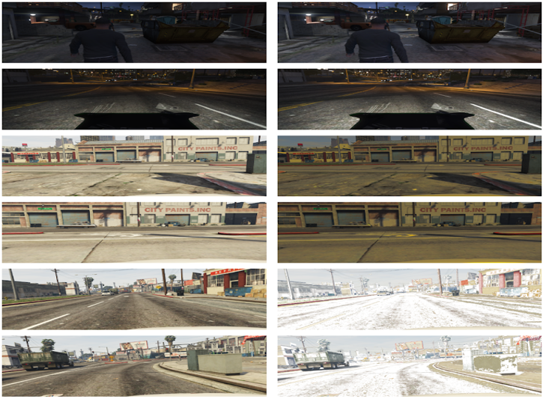
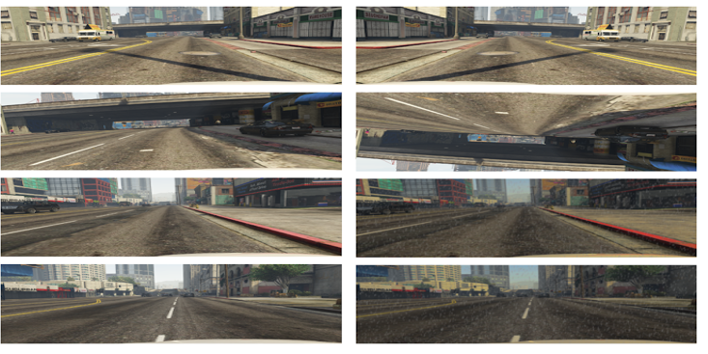
Augmentation Block - Example output

Slide 11
Overview of pipeline

Slide 12
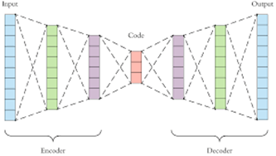
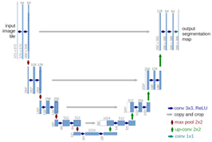
Unet
UNet bases its architecture upon a combination of CNNs with autoencoder (AE) architecture. AEs are neural networks that aim to find a latent space that represents the data in a smaller space as in left fig below. UNet uses the autoencoder architecture for its encoder and decoder parts. A defining feature of UNet is the U shape connection between this encoder-decoder as seen in right fig below.
The UNet architecture we are using contains 4 encoder layers and 4 decoder layers with respective skip connections, each encoder layer is made up of 2 convolution, batchnorm and ReLu layers followed by a maxpool layer and decoder layers are constructed using a convolution transpose layer followed by a series of 2 convolution, batchnorm and ReLu layers.We have chosen this type of network because of restricted resources and time constraints, this network can be swapped for a more complex network like a deeplab v3, for better accuracies, but would cost more computing resources and time.

Slide 13
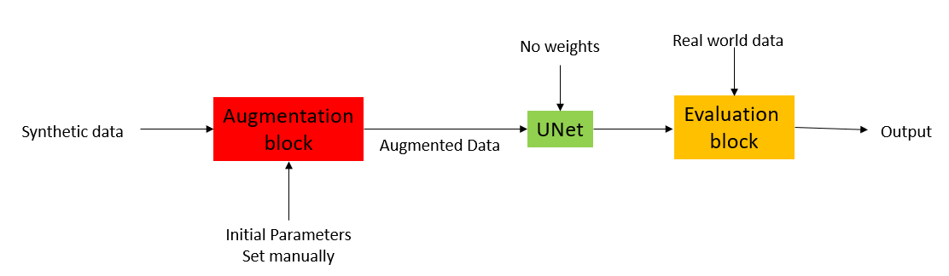
Feedforward
The feedforward network consists of the aug block and the Unet, later it is evaluated on real data. The input images (synthetic data) are loaded using custom data loaders, which have been created to match the labels and color codings of the real world data (cityscapes) and synthetic data (GTA 5). The input synthetic data is then loaded into the augmentation block with some initial parameters (not tuned). The augmentation block performs various augmentations based on the parameters set and gives out a new augmented data loader. The augmented data loader is passed into the UNet for training and the model is saved. With the trained weights, the model predicts the output with the real world (GTA 5) data and an accuracy measure is used to compare the predictions and labels.

Slide 14
Overview of pipeline

Slide 15
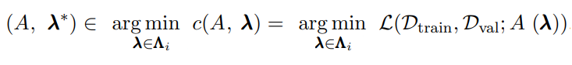
SMAC3
Bayesian Optimization: Two functions are used
1. Surrogate function: estimates how well the model can perform if trained with a certain set of hyperparameters.
2. Selection function: ensures that the set of hyperparameters will improve the model.
SMAC3’s Bayesian optimization:
1. Sample a set of hyperparameters via Sobol Sequence
2. Train a model with them and train a Random Forest surrogate function
3. Select new hyperparameters based on surrogate and selection (logEI) functions
4. Repeat

Slide 16
SMAC3
Setup/Integration:
configspace = ConfigurationSpace({"aug1": (0.0, 0.2),
"aug2": (0.0, 0.2),
"aug3": (0.0, 0.2),
"aug4": (0.0, 0.2),
"aug5": (0.0, 0.2),
"param1": (0.01, 0.99),
"param2": (0.01, 0.99),
"param3": (0.01, 0.99)})
scenario = Scenario({
"run_obj": "quality", # Optimize quality (alternatively runtime)
"runcount-limit": feedback_runs, # Max number of function evaluations (the more the better)
"cs": configspace})
Optimizer = SMAC4HPO(scenario = scenario,tae_runner = train)

Slide 17
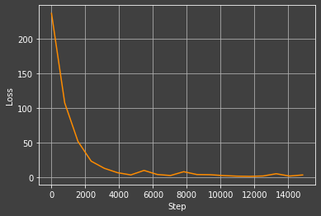
Results Convergence

Slide 18
Results - Comparisons
feedback
Base
Aug
img | acc
1 | 0.1452
6 | 0.2632
11 | 0.3073
img | acc
5 | 0.0046
13 | 0.0010
14 | 0.0003
img | acc
4 | 0.0056
6 | 0.0025
10 | 0.0077
 | Feedback | Base | Aug | +2 epochs
Avg_Accuracy | 0.2447135906 | 0.0054679149 | 0.0044189005 | 0.003535185

Slide 19
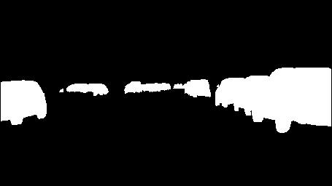
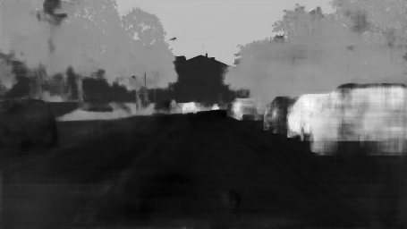
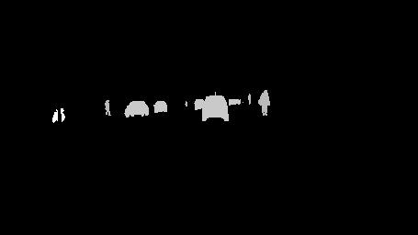
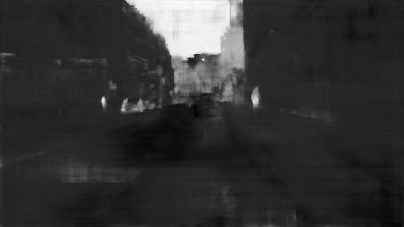
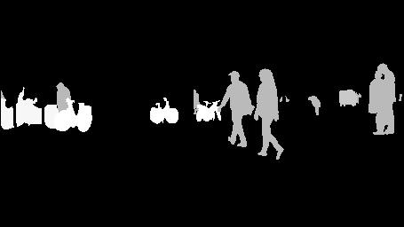
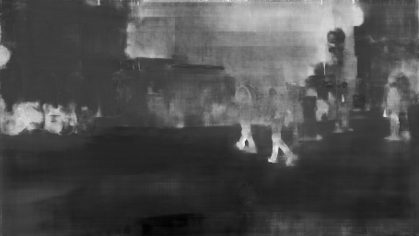
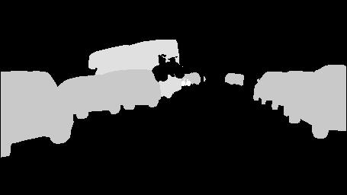
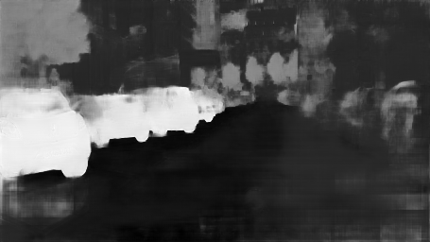
Results Visualization - Feedback

Slide 20
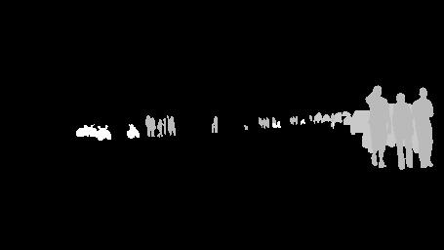
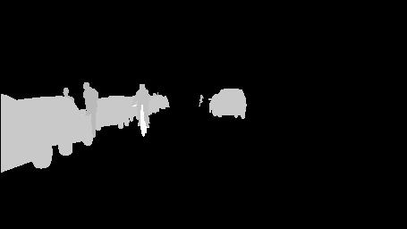
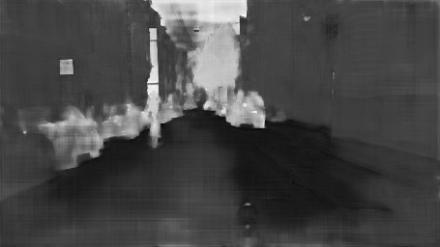
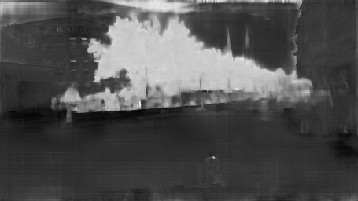
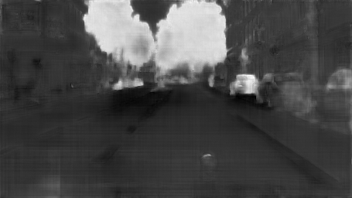
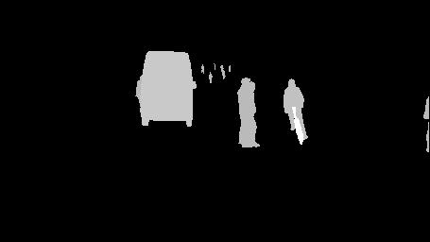
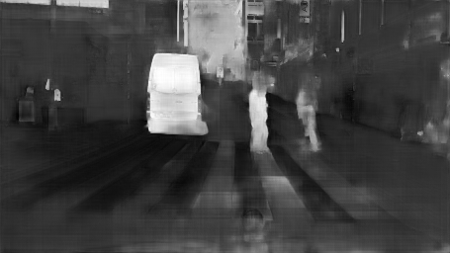
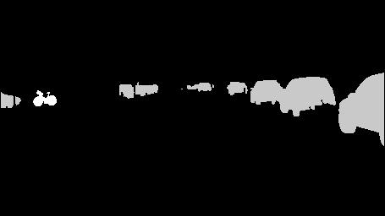
Results Visualization - Base

Slide 21








Results Visualization - Aug

Slide 22

Trade-Offs / Problems
Major problems were computation time and resource limitation
Simple UNet was used instead of complex segmentation networks
Resolution was reduced by a factor 20.
Iterations of training were lowered.
Types of Augmentation were restricted.

Slide 23
Conclusions
We have trained the models to get the best augmentation parameters, which will augment the synthetic data in such a way that it represents the distribution of the real world data. The accuracies obtained provide proof for even further improvements. This could potentially solve scarcity of real world data by substituting with synthetic data.
Future Work
Experimentation with better complex segmentation networks.
Use of different loss functions in model training
Use of different evaluation metrics for feedback network
Using a bigger set of augmentation parameters
Implementation of other types of feedback like RL based, Gradient based.

Slide 24
Questions?

